Slide 1

Machine Learning-Based Detection of Cardiovascular Diseases Presentation 3

Slide 2


Slide 3

Agenda
Introduction
Update
Milestone achieved
Next steps
Result

Slide 4

Introduction
We made a model to extract features from an ECG and classify various types of Heartbeats such as : Normal ( N ), Ventricular ( V ), Atrial ( A ), Right Block ( R ), Left Block ( L ).
From our research we found that CNN was the best model to work on for detection of CVD because of its great feature extraction capabilities.
We preprocessed the data by first denoising it, and then analyzing it.
We denoised the ECG signals using sys4 wavelet transform.
Normalized the data to restrict biased results.
We trained our model on 20000 signals and then tested 5000 signals.

Slide 5
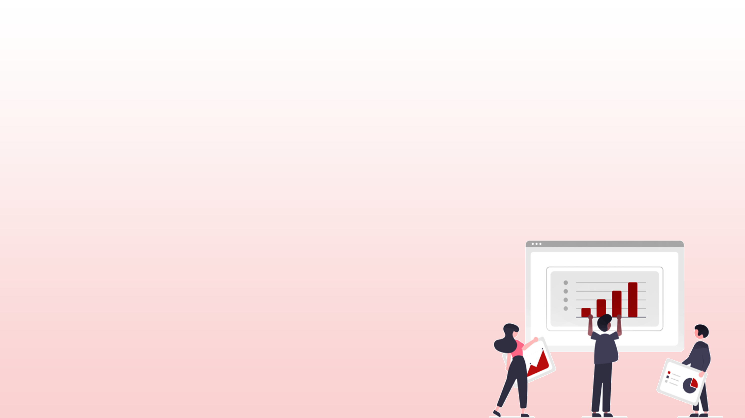
Update
We’ve preprocessed the data and classified 5 classes of arrhythmia. Normal (N), Ventricular (V), Atrial premature beat (A), Right bundle branch block (R), Left bundle branch block (L).
Our problem with data was that it had too much external noise because ECG is affected by environment, industrial noise etc.
For that we used sys4 wavelet transform to get rid of them and denoise the data to have much clear ECGs signals.
We then normalized the signals to get a standard scale for all the signals and patients.

Slide 6

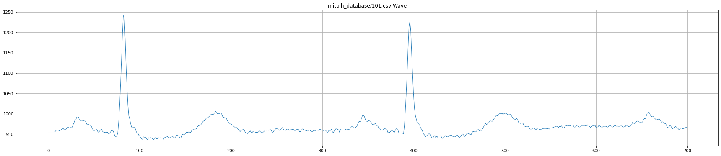
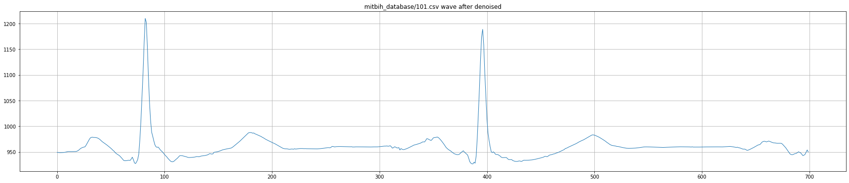
Denoising of Signals

Slide 7
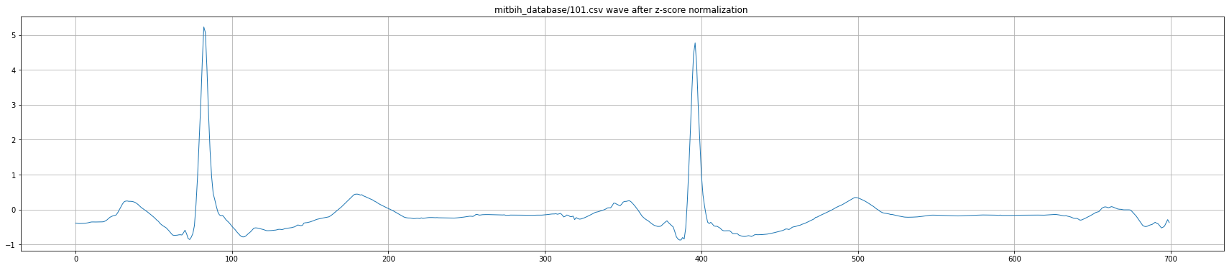
Final Version of Denoised Signal

Slide 8
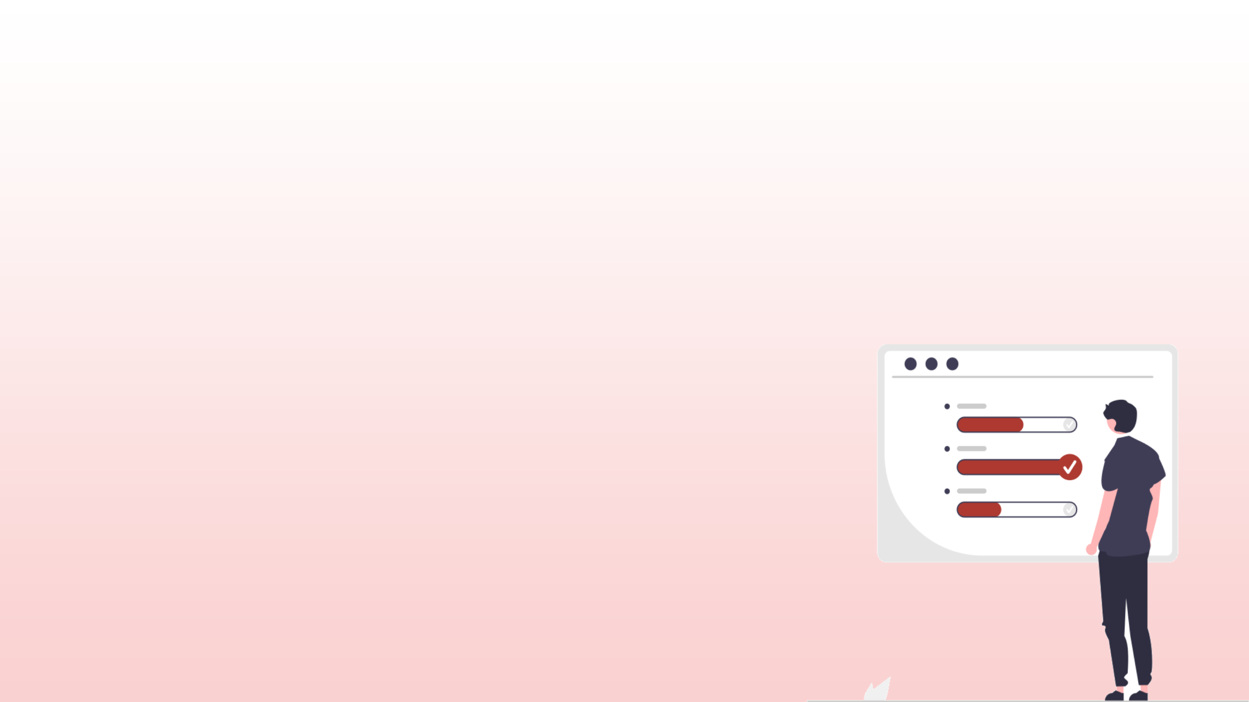
Update
We used A Convolutional Neural Network (CNN) model to train our model.
It contained 6 layers to form the architecture of our CNN model.
Convolution Layer, Average Pooling Layer, Flattening layer, Dropout layer, Dense layer, and Soft max layer (Activation Function).
A convolutional layer is the main building block of a CNN. It contains a set of filters (or kernels), parameters of which are to be learned throughout the training.
Average pooling involves calculating the average for each patch of the feature map.

Slide 9
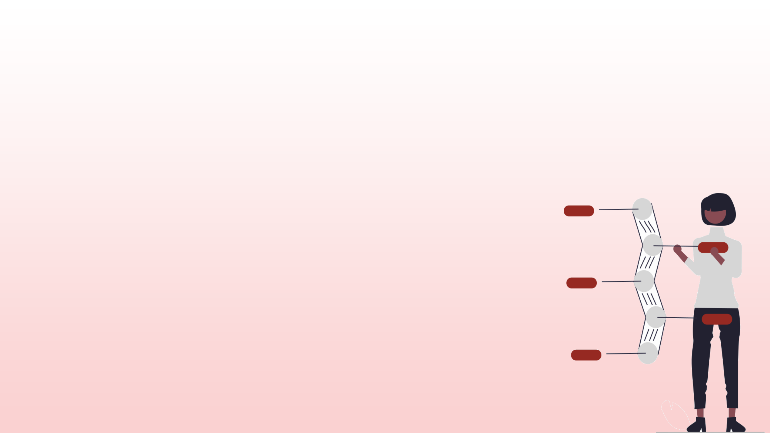
Update
Flattening is used to convert all the resultant 2-Dimensional arrays from pooled feature maps into a single long continuous linear vector.
Dropout layers are important in training CNNs because they prevent overfitting on the training data.
Dense Layer is used to classify signal based on output from convolutional layers.
Softmax is used as the activation function for multi-class classification problems.
After this we finally trained our model with given 20000 samples.
For testing the data we used 5000 samples.
We got a 0.64% test loss score and 98% of test accuracy

Slide 10
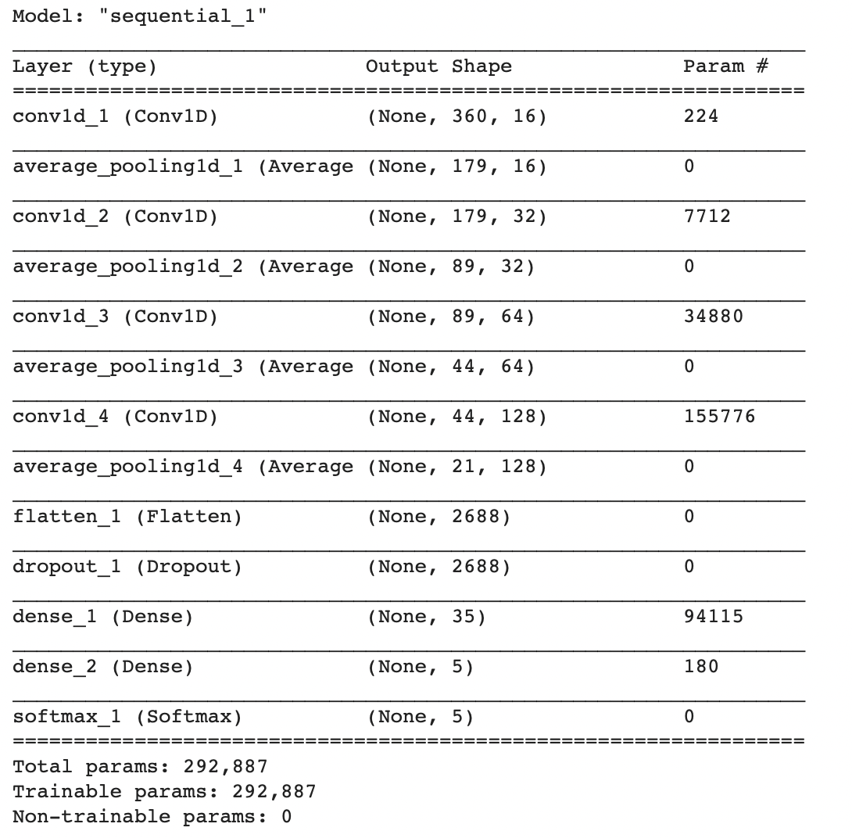
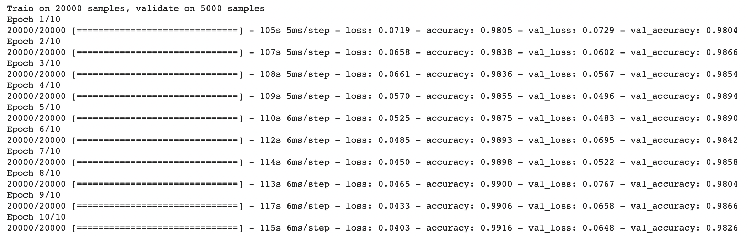
CNN Model Configuration and Results

Slide 11

Milestone achieved
ECG scans in Pakistan vary, so we trained the model that closely aligns with Local ECG sampling rates and environmental noise.
We made sure we had enough data to avoid overfitting.
We found an ideal sampling rate to combine all of our datasets and extract valuable information.

Slide 12

Next Steps
Convert our model into an app.
Use mobile cameras to take picture of ECGs and detect them using Real time image processing.

Slide 13
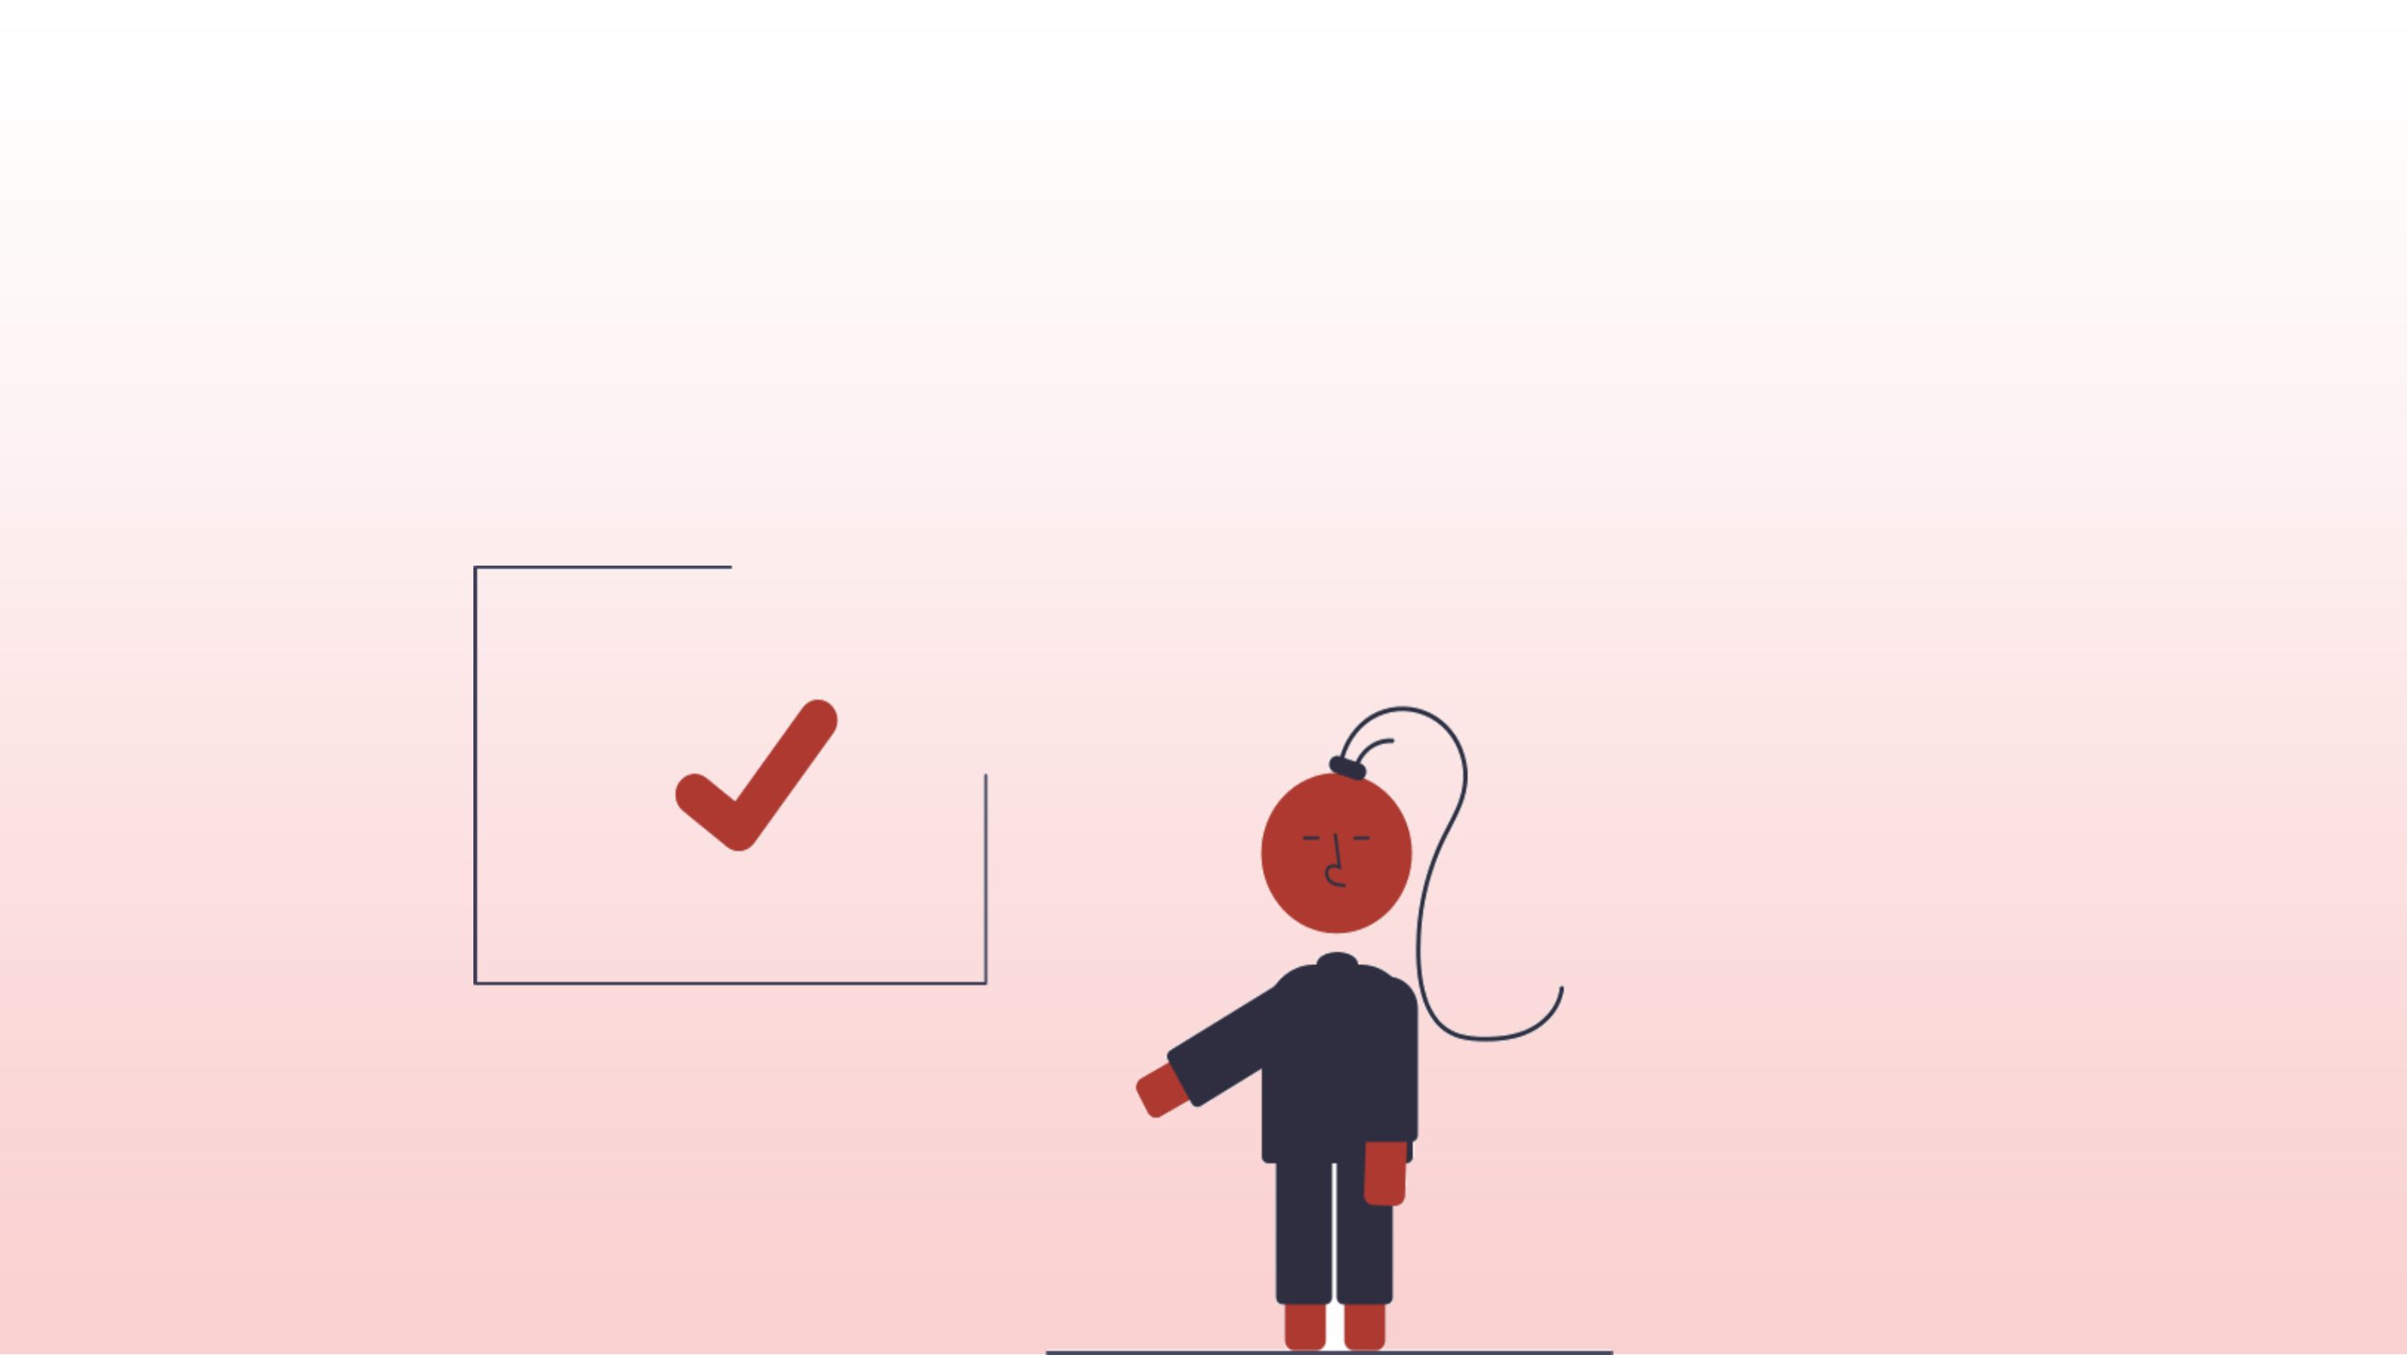
The End
Thank You.

